Slide 1
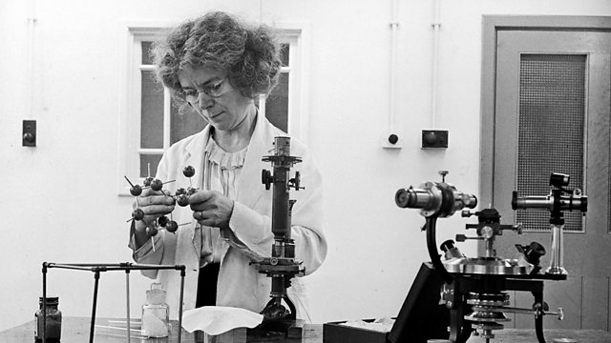
Kathleen Lonsdale
Unusual Bonds

Slide 2
What you should know before you start:
Atoms
Materials are made up of lots of atoms. Atoms are too small to see with the our eyes, or
even a microscope. There are two things which affect the properties of a material: (1) which
atoms it’s made of, (2) how those atoms are arranged. Diamond and graphite (in pencils)
are both made only of carbon atoms, but those carbon atoms are arranged differently, making
them different.
Bonds
In a material, atoms are held together by bonds. Sometimes these bonds are strong and
sometimes they are weak. Molecules are made of small numbers of atoms bonded together.
Slide 1

Slide 3
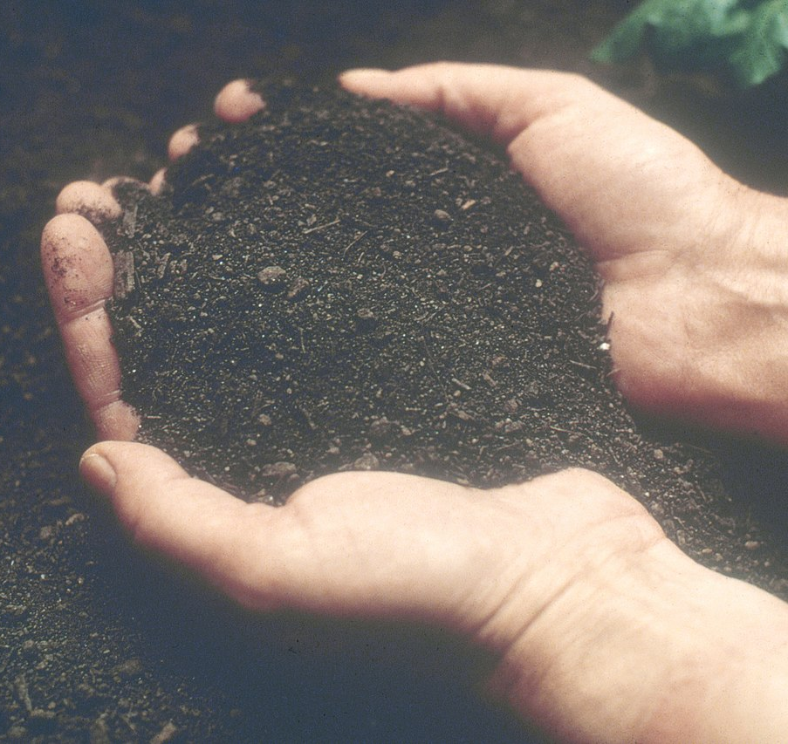
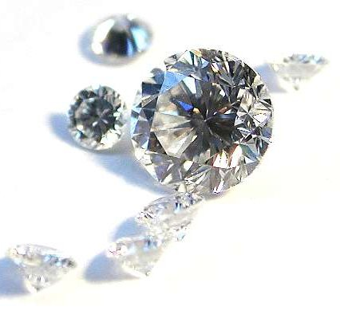
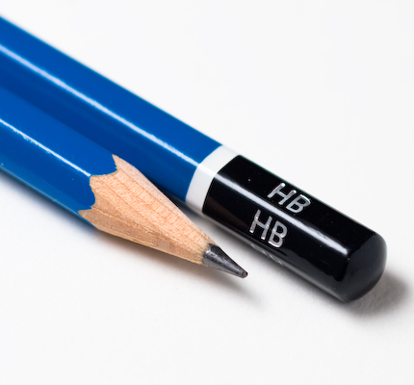
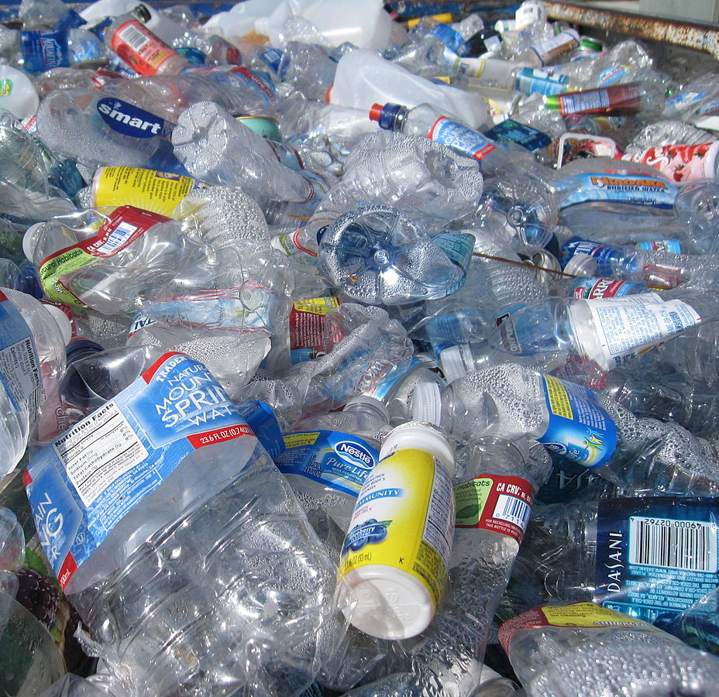
Slide 2
Notes:
Soil: https://en.wikipedia.org/wiki/Soil_regeneration#/media/File:Soil_Survey09_(39041768842).jpg
Diamond: https://en.wikipedia.org/wiki/Diamond_(gemstone)#/media/File:Brillanten.jpg
Oil: https://commons.wikimedia.org/wiki/File:Bottle_of_olive_oil.jpg
Plastic: https://commons.wikimedia.org/wiki/File:Recyclables.JPG
Pencil: https://en.wikipedia.org/wiki/Pencil#/media/File:Pencils_hb.jpg

Slide 4
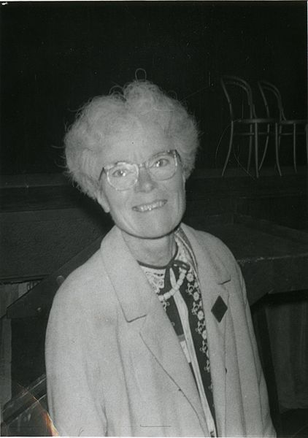
Kathleen Lonsdale
Slide 3
Notes:
https://en.wikipedia.org/wiki/File:Kathleen_Yardley_Lonsdale_(1903-1971).jpg
https://www.bbc.co.uk/programmes/p01ld9qn (not a free image)

Slide 5
Slide 4

Slide 6
Slide 5

Slide 7
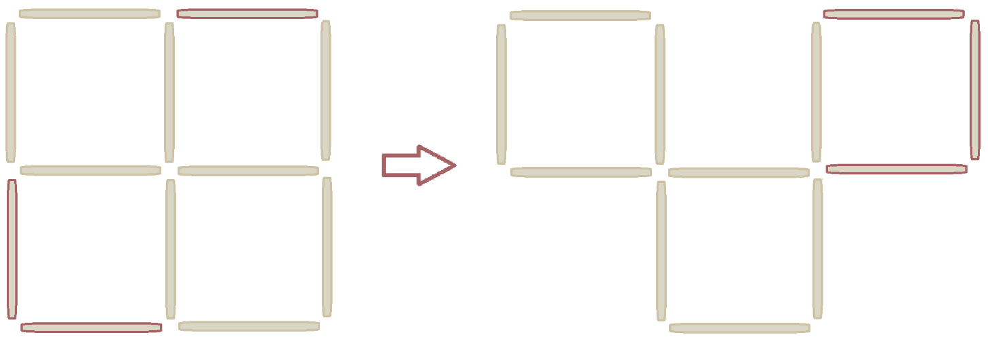
The Answers
Slide 6

Slide 8
Photo credits: Picture of Kathleen and atoms – BBC Woman’s Hour Other images – Wikipedia public domain
© HMDT Music 2020

